Slide 1






Industry 4.0 - Introduction
A seminar about what we are doing and learning in this course
Course code: PPU213
ECTS: 5 (33% ~12-13 hours/week)
Level: First cycle
Mats Ahlskog, Researcher at MDH and course responsible

Slide 2

Outline
Background
About the course
Some examples from the different areas/lectures covered in the course
Additional information

Slide 3
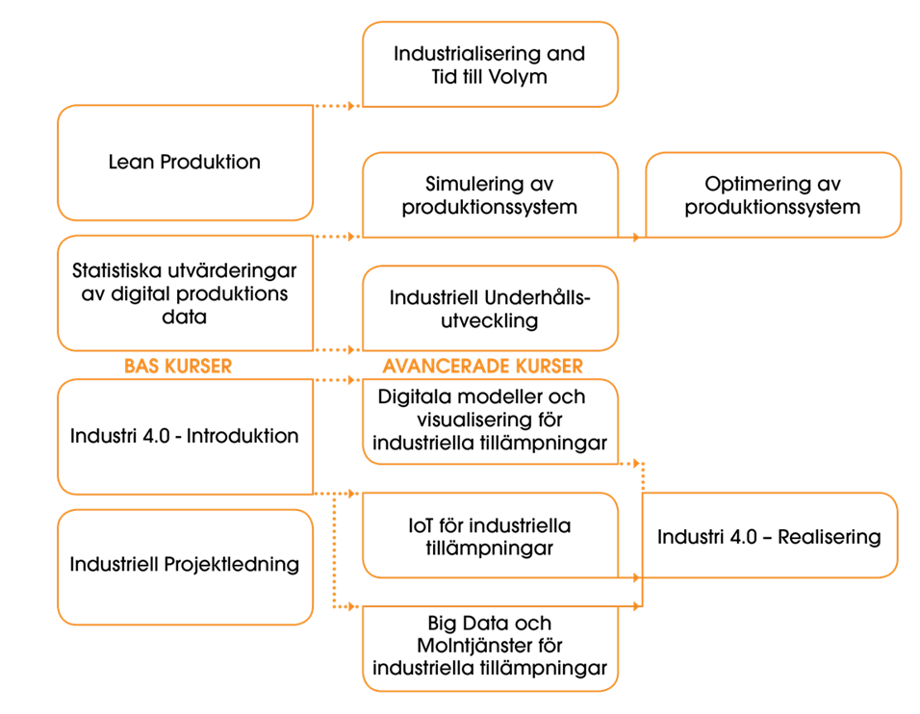
Background
3

Slide 4
Background: Industry 4.0 Introduction
This course provides basic knowledge of industry 4.0. The course gives insight and understanding of the 4th Industrial revolution and how it will impact on the industry and humans. The aim is to give a conceptual understanding of how an industry 4.0 system can be built up and run, as well as an overall understanding of which technologies can be included.
The course includes the following parts
  Introduction to Industry 4.0
  Introduction to the main technologies in Industry 4.0
  The economic drivers for implementing Industry 4.0 technology
  The production and development engineer's role in development of future production system
  The impact of digitization on industry and human beings
The main target group is people in need of understanding the principles of Industry 4.0. The focus is production but anyone from another functions can take this course.
4

Slide 5
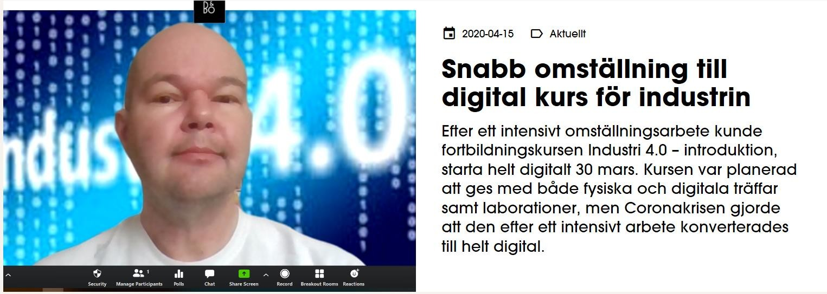
Background
This a new course that is given for the first time
This course was supposed to be held with a combination of meetings at
MDH and online
https://www.mdh.se/samverkan/fortbildning-och-kompetensutveckling-
for-yrkesverksamma/kompetensutveckling-med-premium

Slide 6
Areas covered
Overview industry 4.0
Additive manufacturing
Human perspective
Historical perspective
Augmented reality & Virtual reality
IoT & Cloud & AI & Data analytics
Cyber
security

Slide 7

Course design
A combination of broad and narrow focus is needed
Broad focus
Technology focus
Technology focus
Module 1 | Module 2 | Module 3
Book chapter + reports | Book chapter + reports | Book chapter + reports
Historical perspective Overview industry 4.0 Human perspective | IoT & Cloud AI & Data analytics Cyber security | Augmented reality Virtual reality Additive manufacturing
Discussion on the module topics INL1a | Discussion on the module topics INL1b | Discussion on the module topics INL1c
Own reading
Lecture
Follow-up seminar
All material in the course is digital
7

Slide 8
Course assignments
Assignments | What | When | How | Why
INL1 | Three written assigments based on the moduels in this cours | After each modul | Individual | Check knowledge and way of thinking
Canceled due to Covid-19 LAB | FESTO equipment at MITC AR & VR | One day | Individual | Increase knowledge about digital technologies and relationships
Replacement for the LAB INL2 | Identification of challenges and possibilities - from a report | During the course – final seminar in the end of the course | Individual or group | Increase knowledge about challenges and possibilities
PRO1 | Assessment of your companies maturity level – predefined frameworks | During the course – final presentation in the end of the course | Individual or group | Reflection Bring something back to the company

Slide 9
Teachers
Namn | Roll | E-post | Area
Mats Ahlskog | Examiner, Teacher | mats.ahlskog@mdh.se | Historical perspective
Filip Flankegård | Assistant Teacher | filip.flankegard@mdh.se,
Alessio Bucaioni | Teacher | alessio.bucaioni@mdh.se | Introduction to Ind 4.0
Rachel Tripny Berglund | Teacher | rachael.tripney.berglund@mdh.se | Human perspective
Moris Benham | Teacher | moris.behnam@mdh.se | IoT & Cloud
Markus Bohlin | Teacher | markus.bohlin@mdh.se | AI & Data analytics
Francesco Flammini | Teacher | francesco.flammini@mdh.se | Cybersecurity
Christopher Gustafsson | Teacher | christopher.gustafsson@mdh.se | Additive Manufacturing
Barrett Sauter | Teacher | barrett.sauter@mdh.se | AR & VR
I wanted to include as many as possible different knowledge domains and perspectives in this course

Slide 10
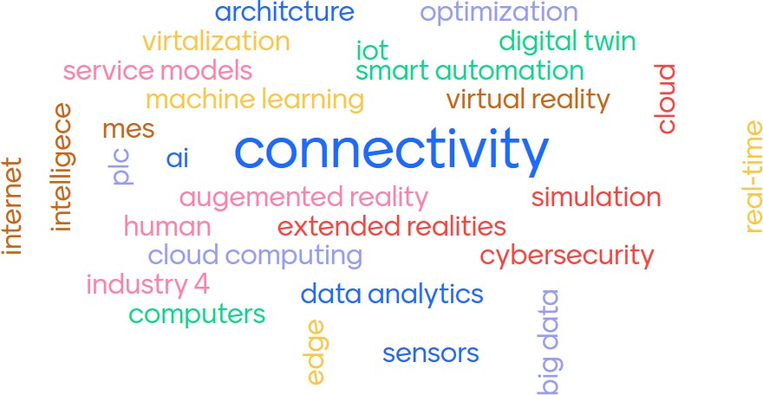
Introduction to the main technologies and terminology

Slide 11
Module 1 – Broad focus
Historical perspective - Mats Ahlskog
mats.ahlskog@mdh.se
Overview industry 4.0 - Alessio Bucaioni
alessio.bucaioni@mdh.se
Human perspective - Rachel Tripny Berglund
rachael.tripney.berglund@mdh.se
I have borrowed some slides from their lecturers

Slide 12
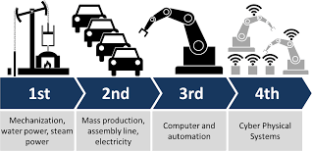
Module 1 – Broad focus
What is Industry 4.0?
That is something we discuss during the course
Industry 4.0, was first declared by German government during Hannover Fair in 2011 as the beginning of the 4th industrial revolution.

Slide 13
Module 1 – Timeline 1st Ind. revolution
Where started the first industrial revolution?
The first industrial
revolution is generally said starting in the beginning of the 1700’s England who is
Communication
1844 - Baltimore and Washington shared the world’s first telegraph line and by using this innovation, news could be sent faster
1750 1800 1850 1900 1950 2000 2050
the cradle of modern
industry Säfsten, 2002).
(Bellgran and 2010; Marks,
Why England?
Today 2020
1700
1733 The
flying shuttle
1830 – The first railway in the world was built between Manchester and Liverpool
Hannover Fair in 2011
1764 - Spinning
Jenny
Textile industry
Transportation of people and material

Slide 14
Module 1 – Timeline 3rd
Ind. revolution
4th Industrial revolution
3rd Industrial revolution
Advancement of
several technologies
Connectivity
1991 The World Wide Web
1976-77 -Entry of Radio Shack, Apple, and Commodore into the market.
1993 The first Web browser
1945 ENIAC
Today 2020
1940-2000
2000-2040
1973 ASEA IRB6
1947 Transistor
1958 - The invention of the integrated
circuit
1968 – 1971
Programmable controllers and Programmable Logic
Controller (PLC)
As late as 1990, only 22 percent of U.S. households had a computer
2007 Apple iPhone launched
Hannover Fair in 2011 - German concept “Industry 4.0
Computerization and automation

Slide 15
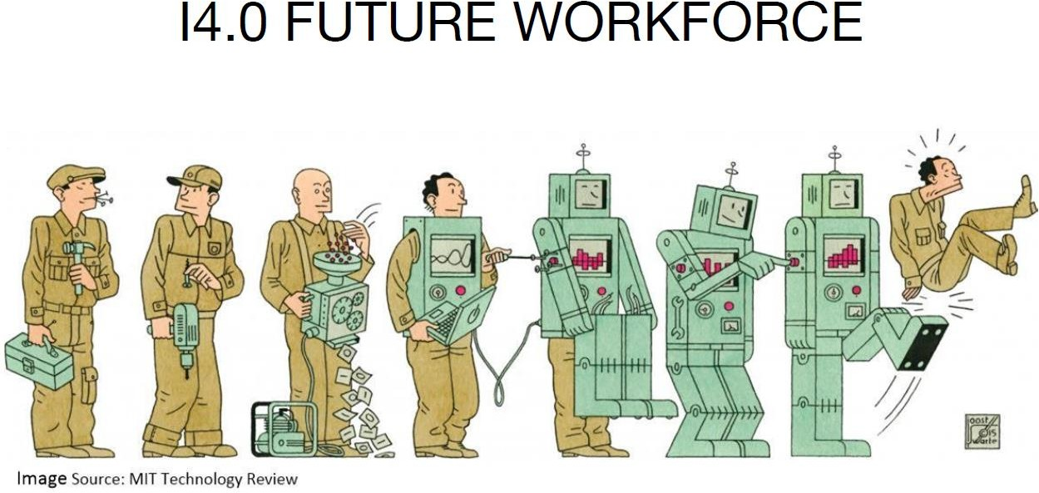
Module 1
Based on the past – what will happen?
How will this digital transformation affect us as humans?

Slide 16

Module 1
Change management (digitalization) from a human perspective
Work environment

Slide 17
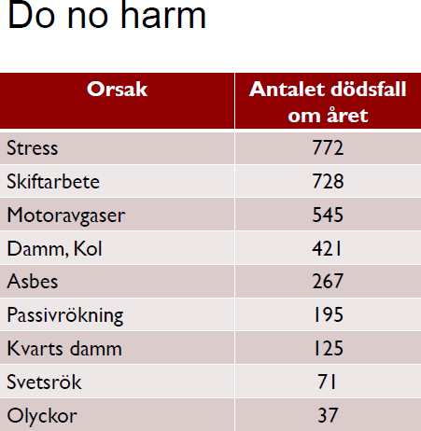
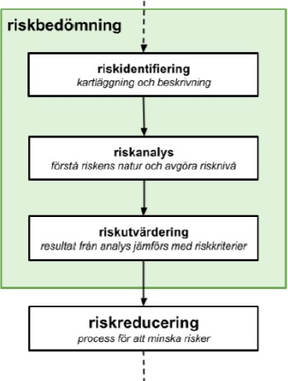
Module 1

Slide 18
Module 1 – Some examples from follow-up seminar
People will lose their jobs in some areas
Lifelong learning
Laws & Regulations
More work from home
  Less social interaction
  Difficult to separate work and private life
Less distinction between white and blue collars
Bigger gap between specialists and generalists/workers prevalence and domination of AI and robotics in offices and workspace

Slide 19
Module 2
– Technology focus
IoT & Cloud – Professor Moris Benham
moris.behnam@mdh.se
AI & Data analytics – Professor Markus Bohlin
markus.bohlin@mdh.se
Cybersecurity – Professor Francesco Flammini francesco.flammini@mdh.se
I have borrowed some slides from their lecturers

Slide 20
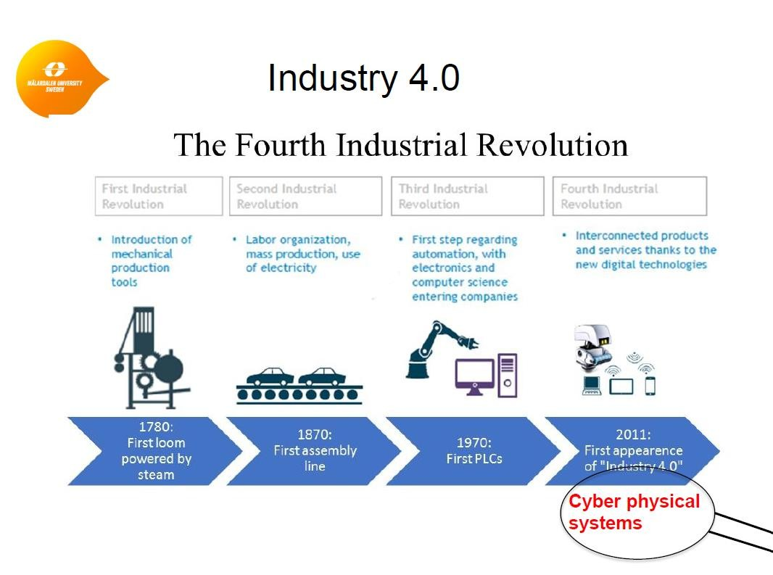
Module 2 – IoT & Cloud
2
0

Slide 21
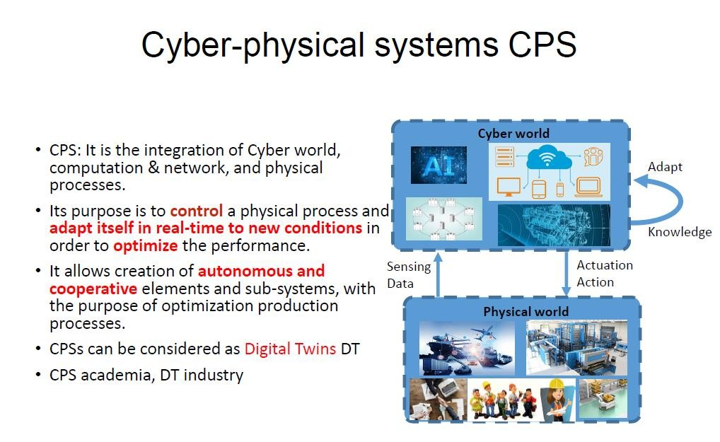
Module 2 – IoT & Cloud

Slide 22
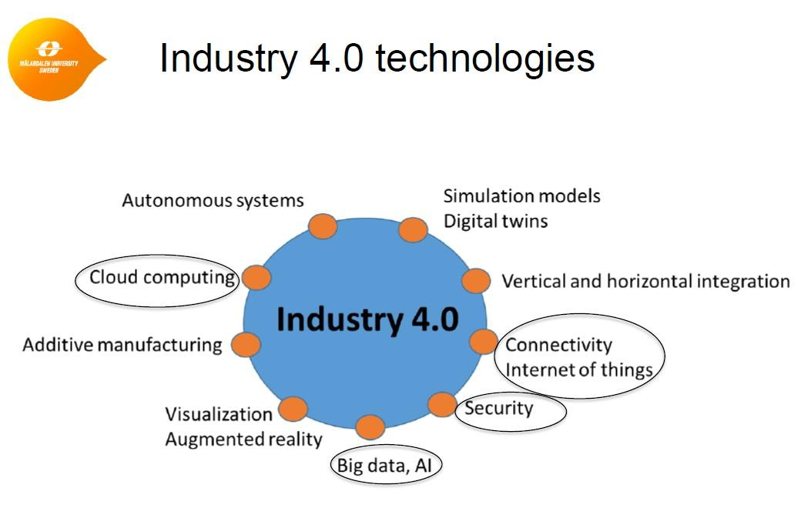
Module 2 – IoT & Cloud

Slide 23
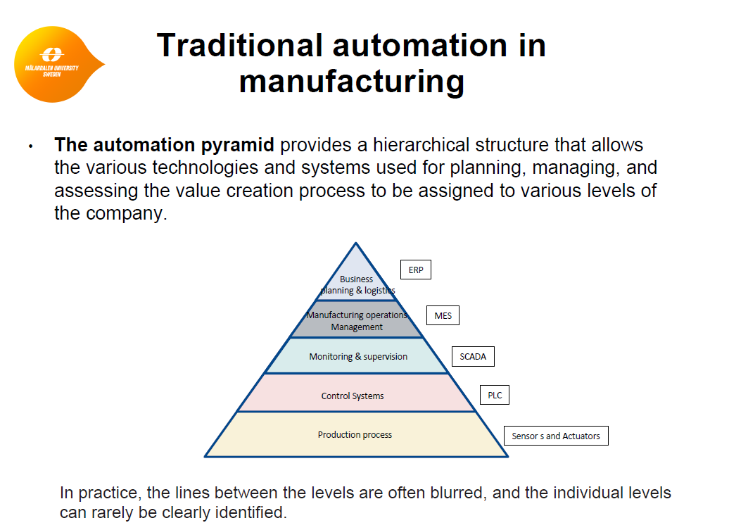
Module 2 – IoT & Cloud

Slide 24
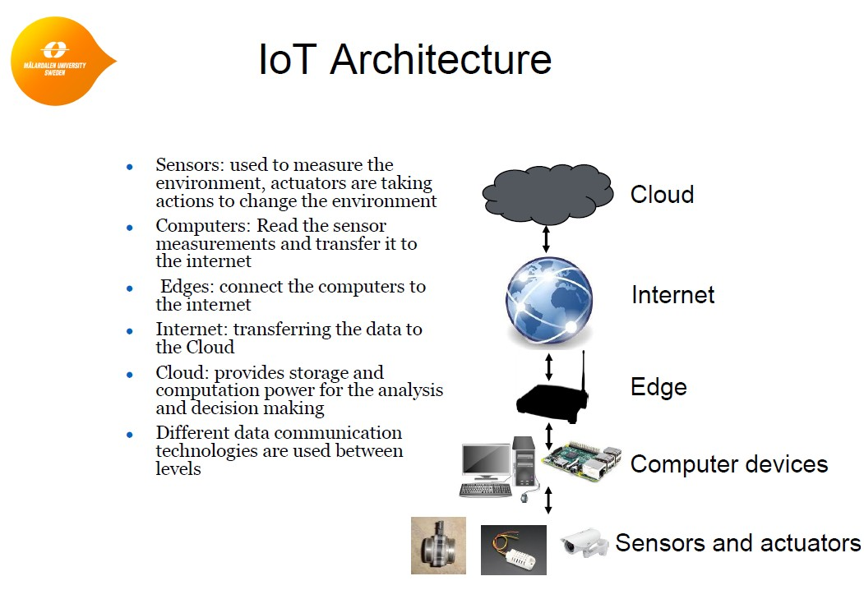
Module 2 – IoT & Cloud

Slide 25
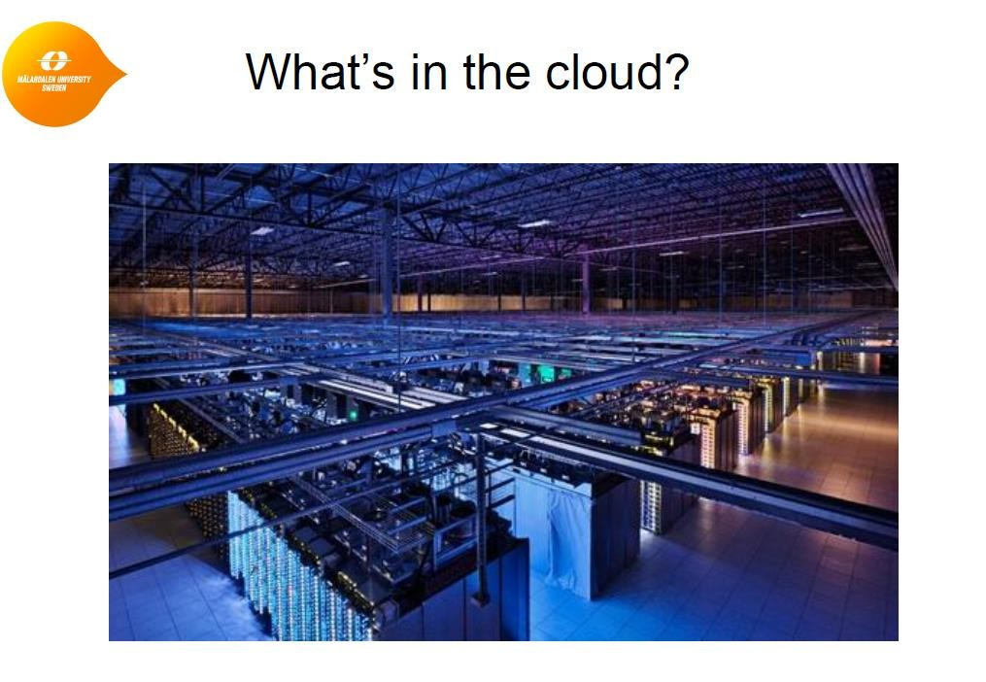
Module 2 – IoT & Cloud

Slide 26
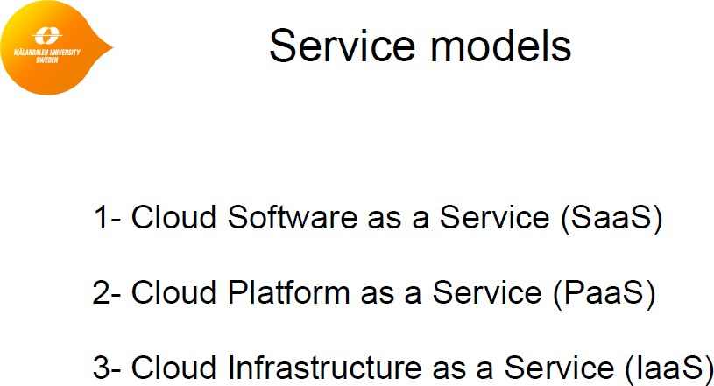
Module 2 – IoT & Cloud

Slide 27
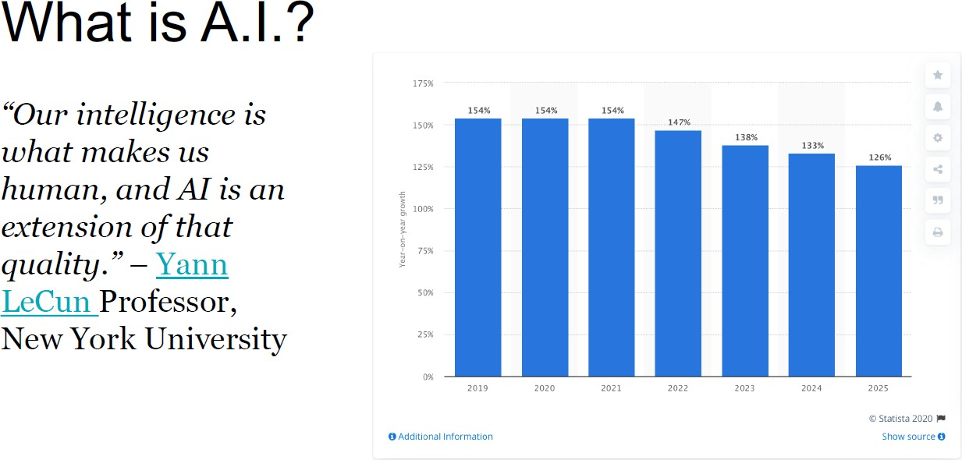
Module 2 – AI & Data analytics

Slide 28
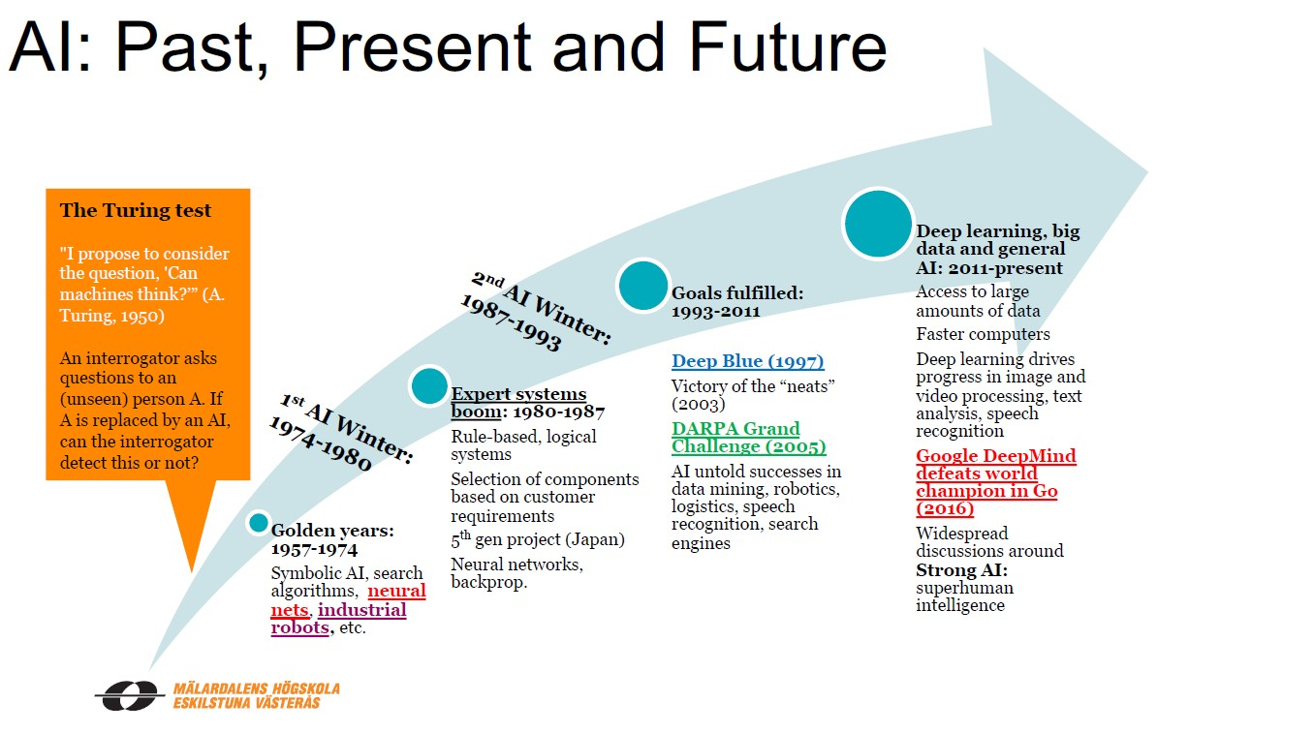
Module 2 – AI & Data analytics

Slide 29
Module 2 – AI & Data analytics
Basic introduction to:
Different challenges within A.I.
The Industrial A.I. stack
Data cleaning and preparation
Optimization in artificial intelligence
Some problems in Machine Learning
  Overtraining

Slide 30
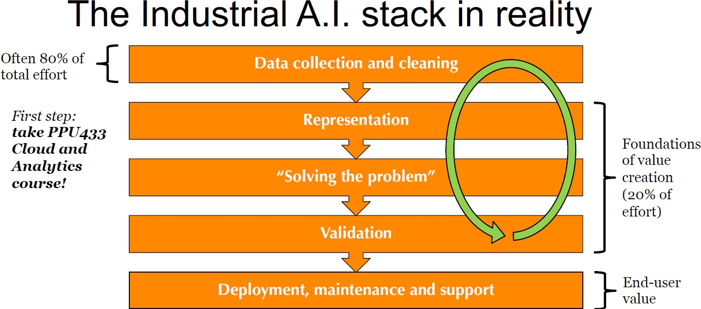
Module 2 – AI & Data analytics

Slide 31
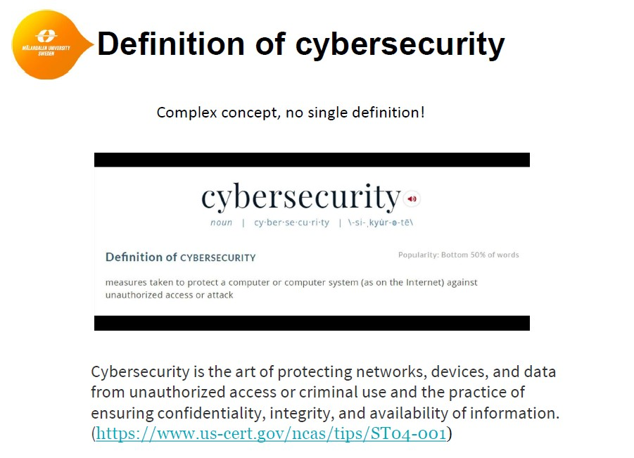
Module 2 – Cybersecurity

Slide 32
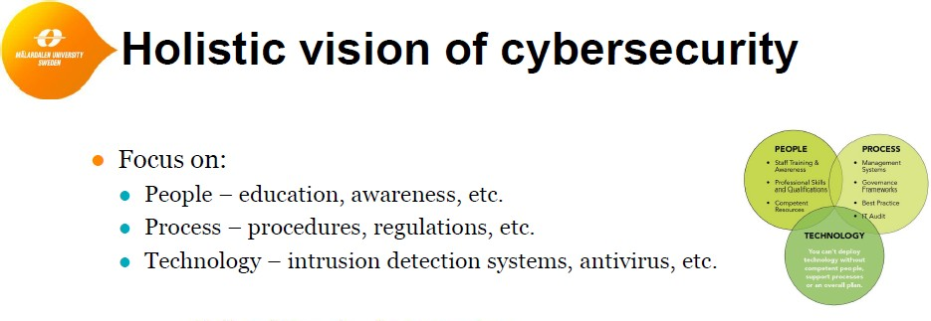
Module 2 – Cybersecurity

Slide 33
Module 2 – Cybersecurity
Importance of cybersecurity
Cybersecurity in Industry 4.0
Cyber-physical systems (CPS) security
Security threats to intelligent systems
Vulnerability Assessment
Examples of some classic cyberattacks (STUXNET, Denial of Service (DoS) attacks
Etc.

Slide 34
Module 3
Augmented reality & Virtual reality - Barrett Sauter
barrett.sauter@mdh.se
Additional lectures - Not covered in this presentation
FESTO-Overview Leo Hatvani
leo.hatvani@mdh.se
Special lecture – From theory to practice – how to implement Ind 4.0 –
Mats Ahlskog
Not covered in this presentation – lecture next week
Additive manufacturing - Christopher Gustafsson
christopher.gustafsson@mdh.se
I have borrowed some slides from their lecturers

Slide 35
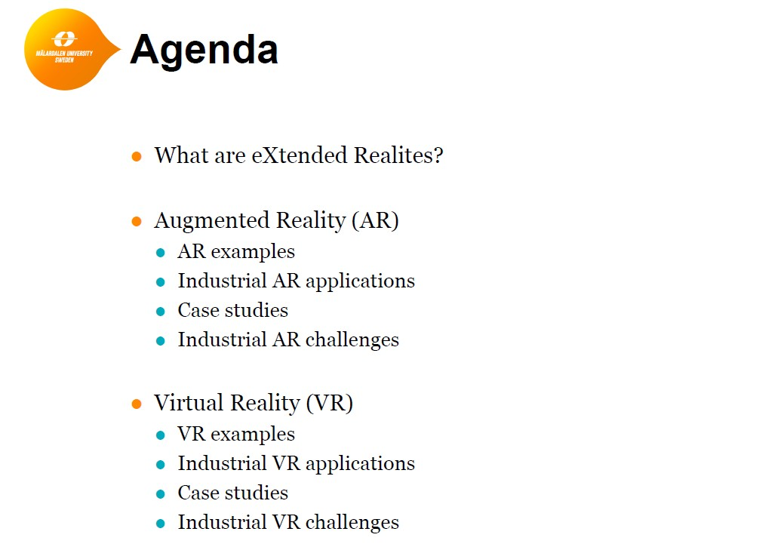
Module 3 - Augmented reality

Slide 36
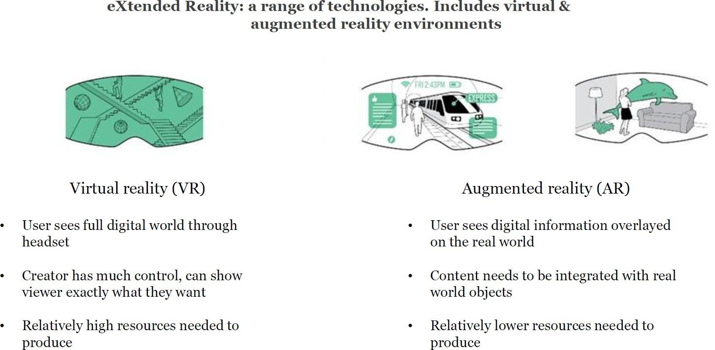
Module 3 - Augmented reality

Slide 37
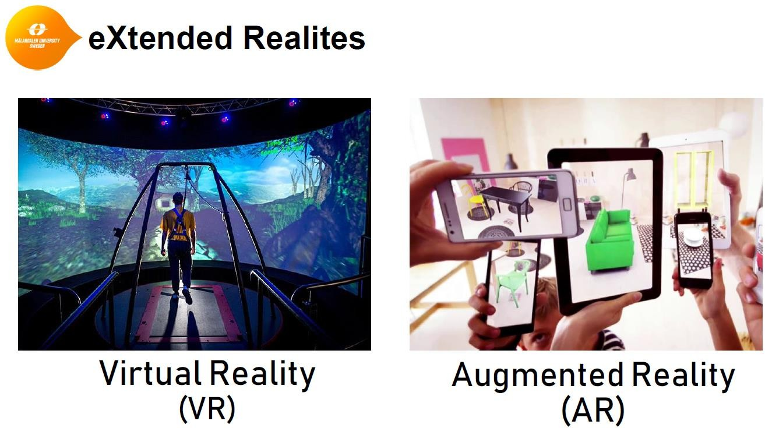
Module 3 - Augmented reality

Slide 38
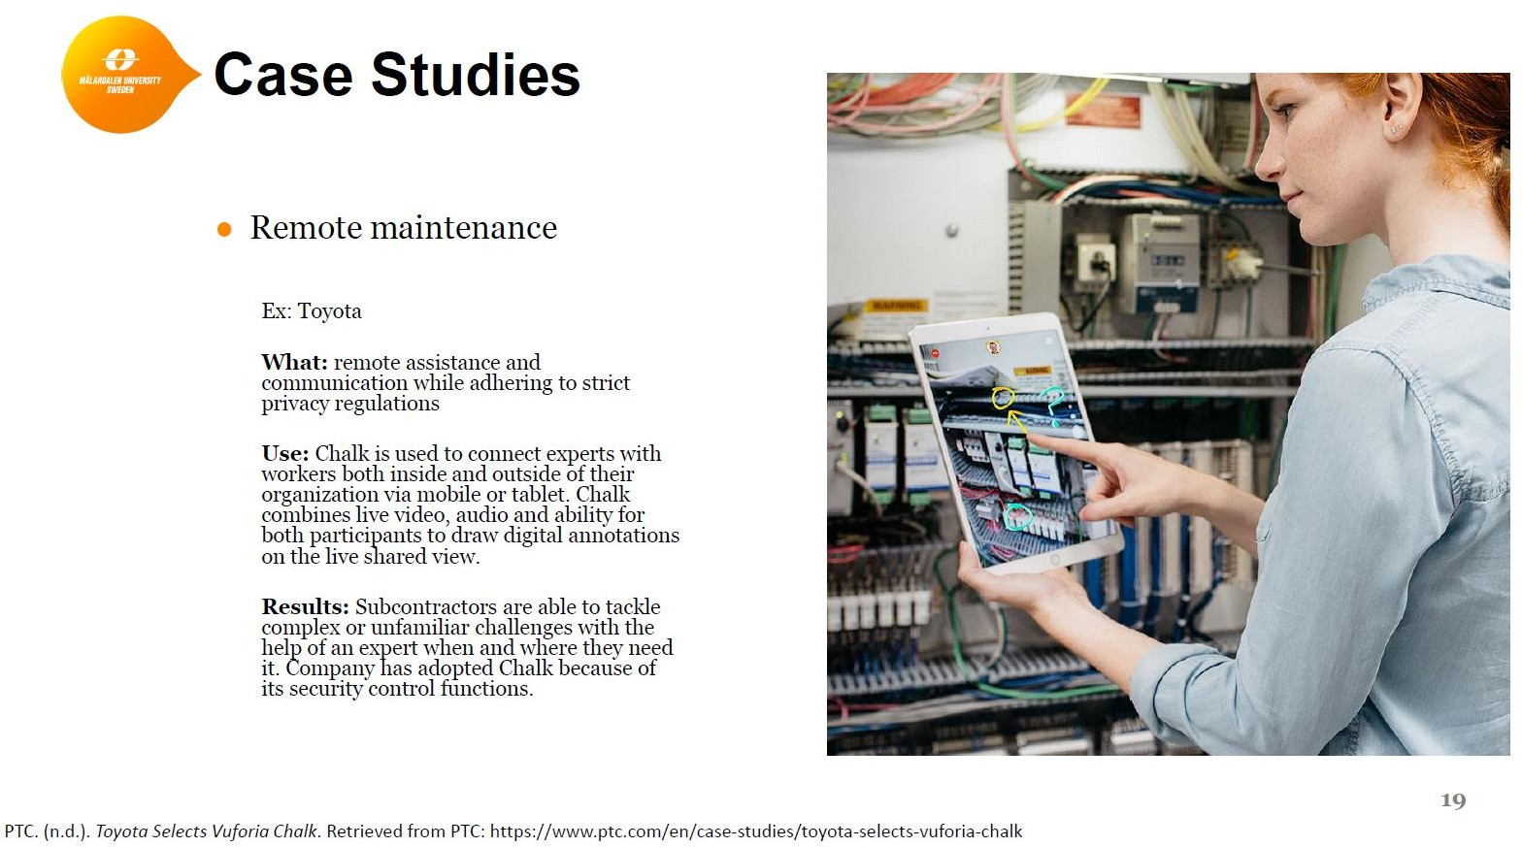
Module 3 - Augmented reality

Slide 39
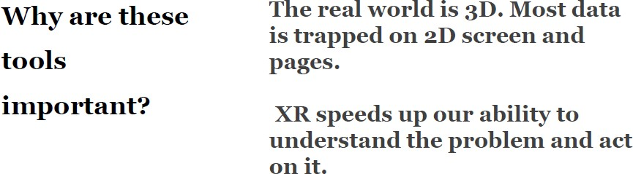
Module 3 - Augmented reality & Virtual reality

Slide 40
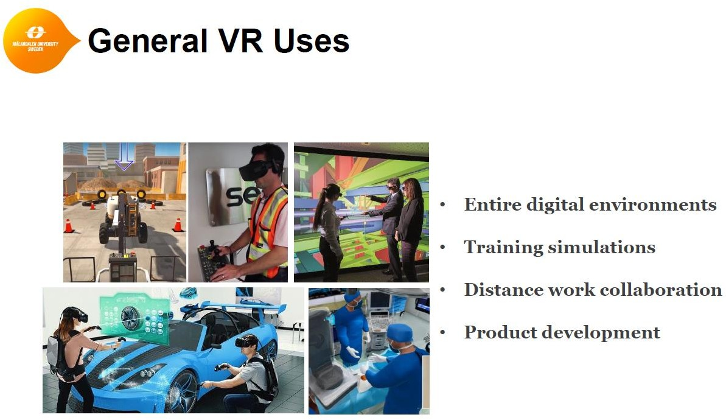
Module 3 - Virtual reality

Slide 41
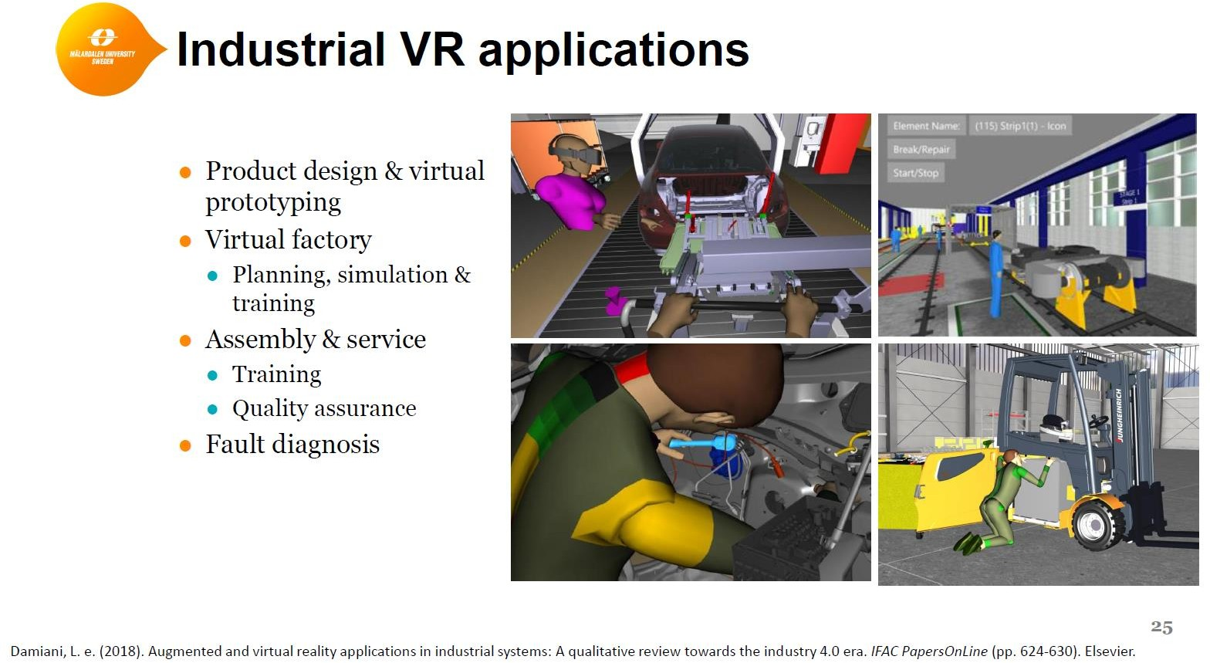
Module 3 - Virtual reality

Slide 42
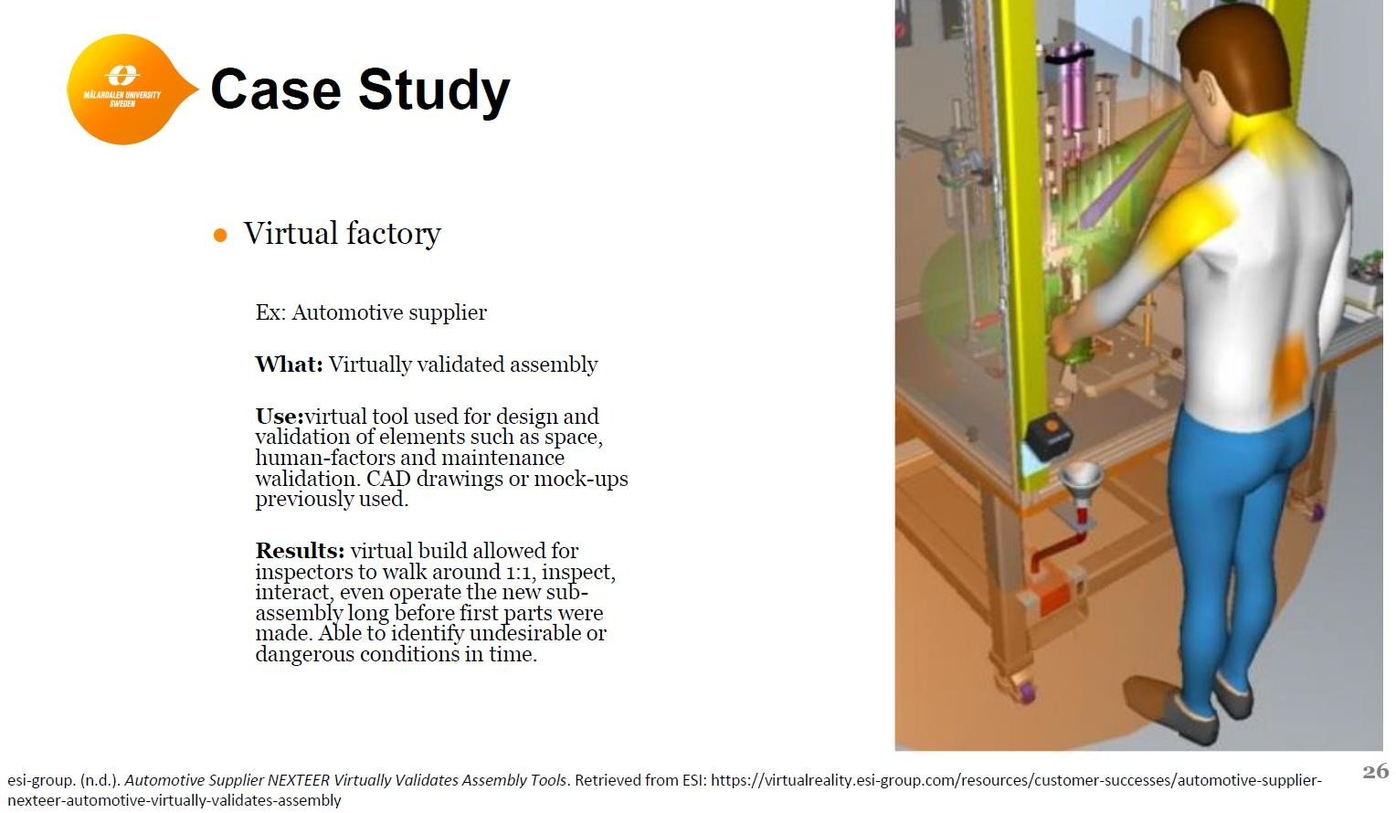
Module 3 - Virtual reality

Slide 43
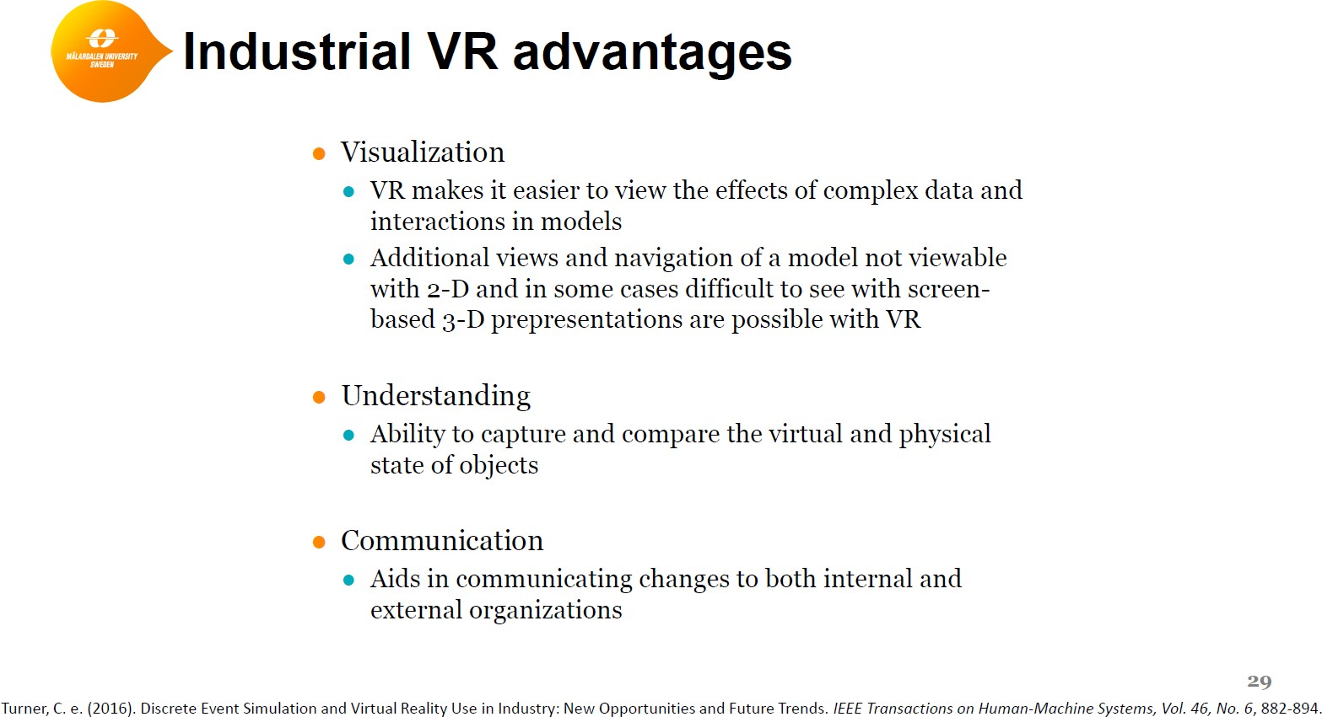
Module 3 - Virtual reality

Slide 44
Additional information

Slide 45
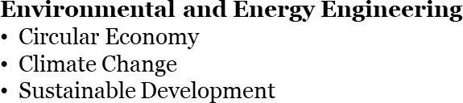
Lifelong Learning at Mälardalen University
Courses for professionals
Developed in close cooperation with industry
Production Engineering
  Industry 4.0
  Lean Production
  Simulation
Software Engineering
  Dependable Software
  Internet-of-Things
  Software Test
Applied AI
  Big Data
  Machine Learning
  Predictive Analytics
Gives university credits
Free-of-charge for employees in Sweden and EU/EEA and Swiss citizens
Innovation Management
Trendspotting and scenariodesign
Innovation Management
mdh.se/en/malardalen-university/education/further-training
45

Slide 46

Seminar series Industry 4.0
Date | Title | Teacher
May 15 | Industrial Internet of Things and the Opportunities in Manufacturing | Mohammad Ashjaei & Moris Behnam
May 29 | Artificial Intelligence | Markus Bohlin
June 5 | Simulation for evaluation and improvement of production systems | Ioanna Aslanidou
June 12 | Introduction to industrial cybersecurity | Francesco Flammini
June 26 | AR and VR for Industry 4.0: From Development to Maintenance | Leo Hatvani
August 14 | Maintenance | Antti Salonen
August 21 | Additive Manufacturing – The MDH way | Christopher Gustafsson
August 28 | Cobot | Mikael Hedelind
September 4 | Optimization of Production Systems | Konstantinos Kyprianidis & Yuanye Zhou & Stavros Vouros
September 11 | Industrialization: a multiple perspectives | Koteshwar Chirumalla
46

Slide 47
Production engineering courses autumn 2020
(5 credits/course)
Lean production
Study period 2020-08-31 - 2020-11-08
Internet of Things for the manufacturing industry
Study period 2020-08-31 - 2020-11-08
Simulation of production systems
Study period 2020-08-31 - 2020-11-08
Big Data and Cloud Computing for Industrial Applications
Study period 2020-11-09 - 2021-01-17
Industrial maintenance development
Study period 2020-11-09 - 2021-01-17
For more information, visit mdh.se/premium
47

Slide 48
Production engineering courses spring 2021
(5 credits/course)
Optimization of production systems
Study period 2021-01-18 – 2021-03-28
Visualization for industrial applications
Study period 2021-01-18 – 2021-03-28
Industry 4.0 – Introduction
Study period 2021-03-29 - 2021-06-06
Industry 4.0 – Realisation
Study period 2021-03-29 - 2021-06-06
Industrialization and Time-to-Volume
Study period 2021-03-30 - 2021-06-08
For more information, visit mdh.se/premium
48

Slide 49
Questions & Answers

